Slide 1
Data Structures Chapter 7: Graph
Introduction
Terminology, Representation, ADT
Basic Operations
DFS, CC, BFS, Processing
Digraph and Applications
Minimum Spanning Tree(MST)

Slide 2
너는 청년의 때에 너의 창조주를 기억하라. 곧 곤고한 날이 이르기 전에, 나는 아무 낙이 없다고 할 해들이 가깝기 전에 (전도서 12:1)
모든 사람이 죄를 범하였으매 하나님의 영광에 이르지 못하더니 그리스도 예수 안에 있는 속량으로 말미암아 하나님의 은혜로 값없이 의롭다 하심을 얻은 자 되었느니라 (로마서 3:23-24)

Slide 3
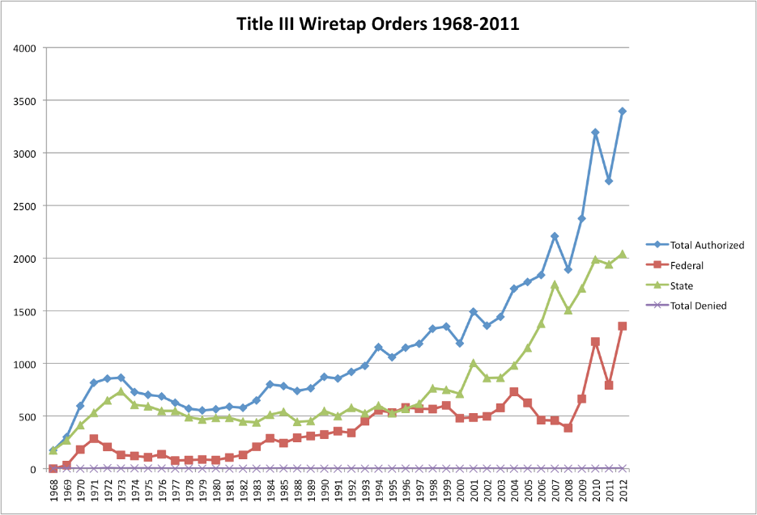
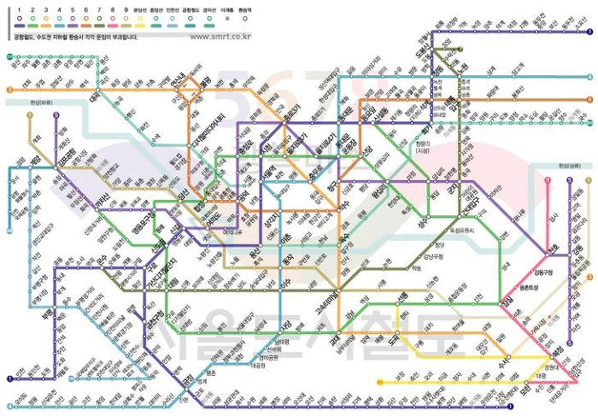
Undirected graphs
Graph: Set of vertices connected pairwise by edges
Why study graph algorithms?
Thousands of practical applications.
Hundreds of graph algorithms known.
Interesting and broadly useful abstraction.
Challenging branch of computer science and discrete math.

Slide 4
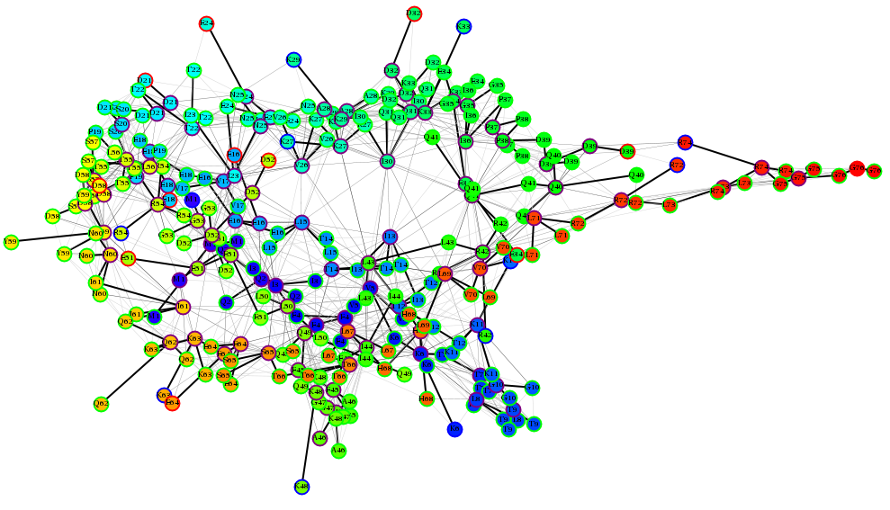
Undirected graphs
Chemical Environments: Protein Graphs
Reference: Benson NC, Daggett V (2012) A comparison of methods for the analysis of molecular dynamics simulations. J. Phys. Chem. B 116(29): 8722-31.

Slide 5
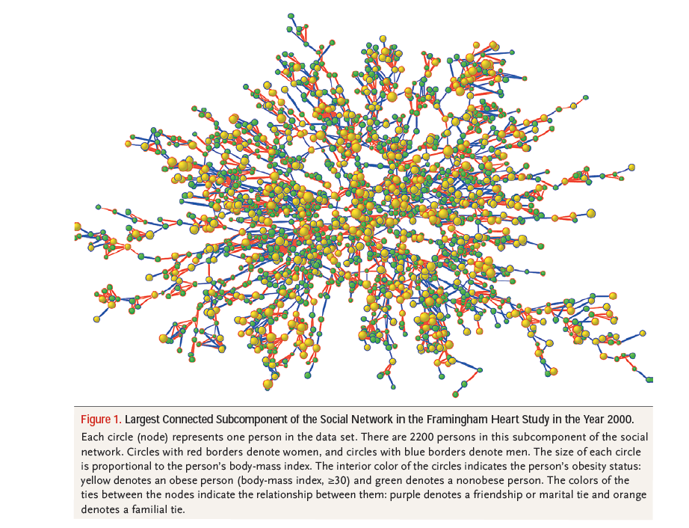
Undirected graphs
The Spread of Obesity in a Large Social Network over 32 Years
http://www.youtube.com/watch?v=pJfq-o5nZQ4
http://www.nejm.org/doi/full/10.1056/NEJMsa066082

Slide 6
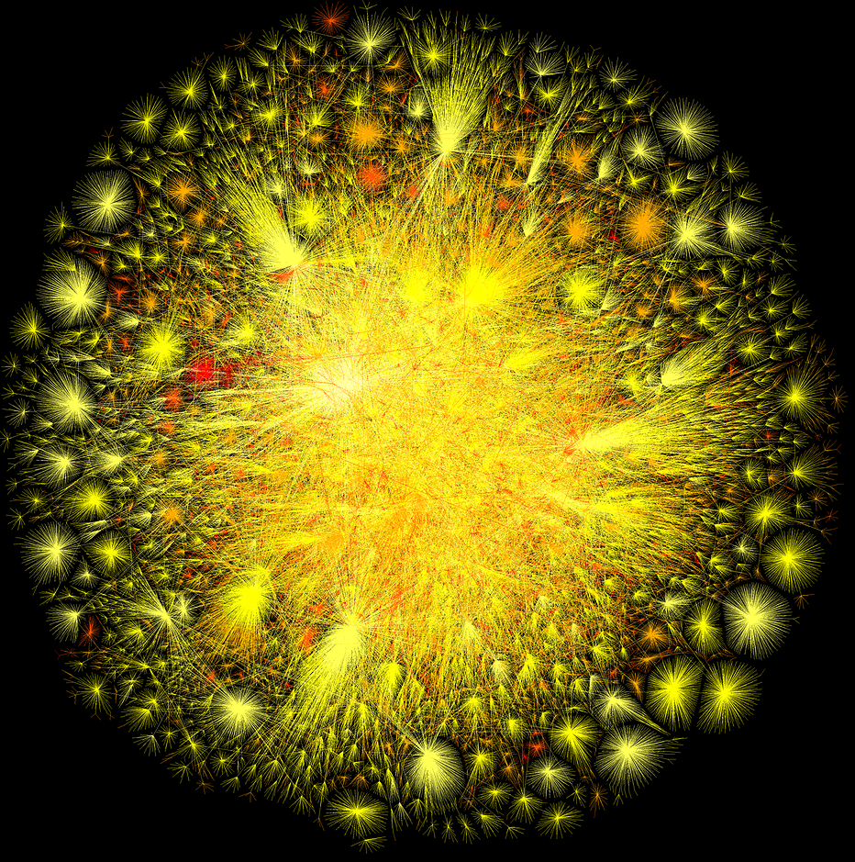
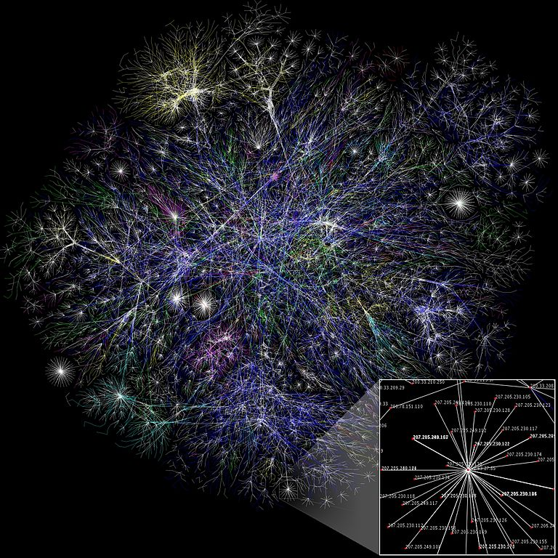
Undirected graphs
the Opte Project: Visualization of the various routes through a portion of the Internet

Slide 7
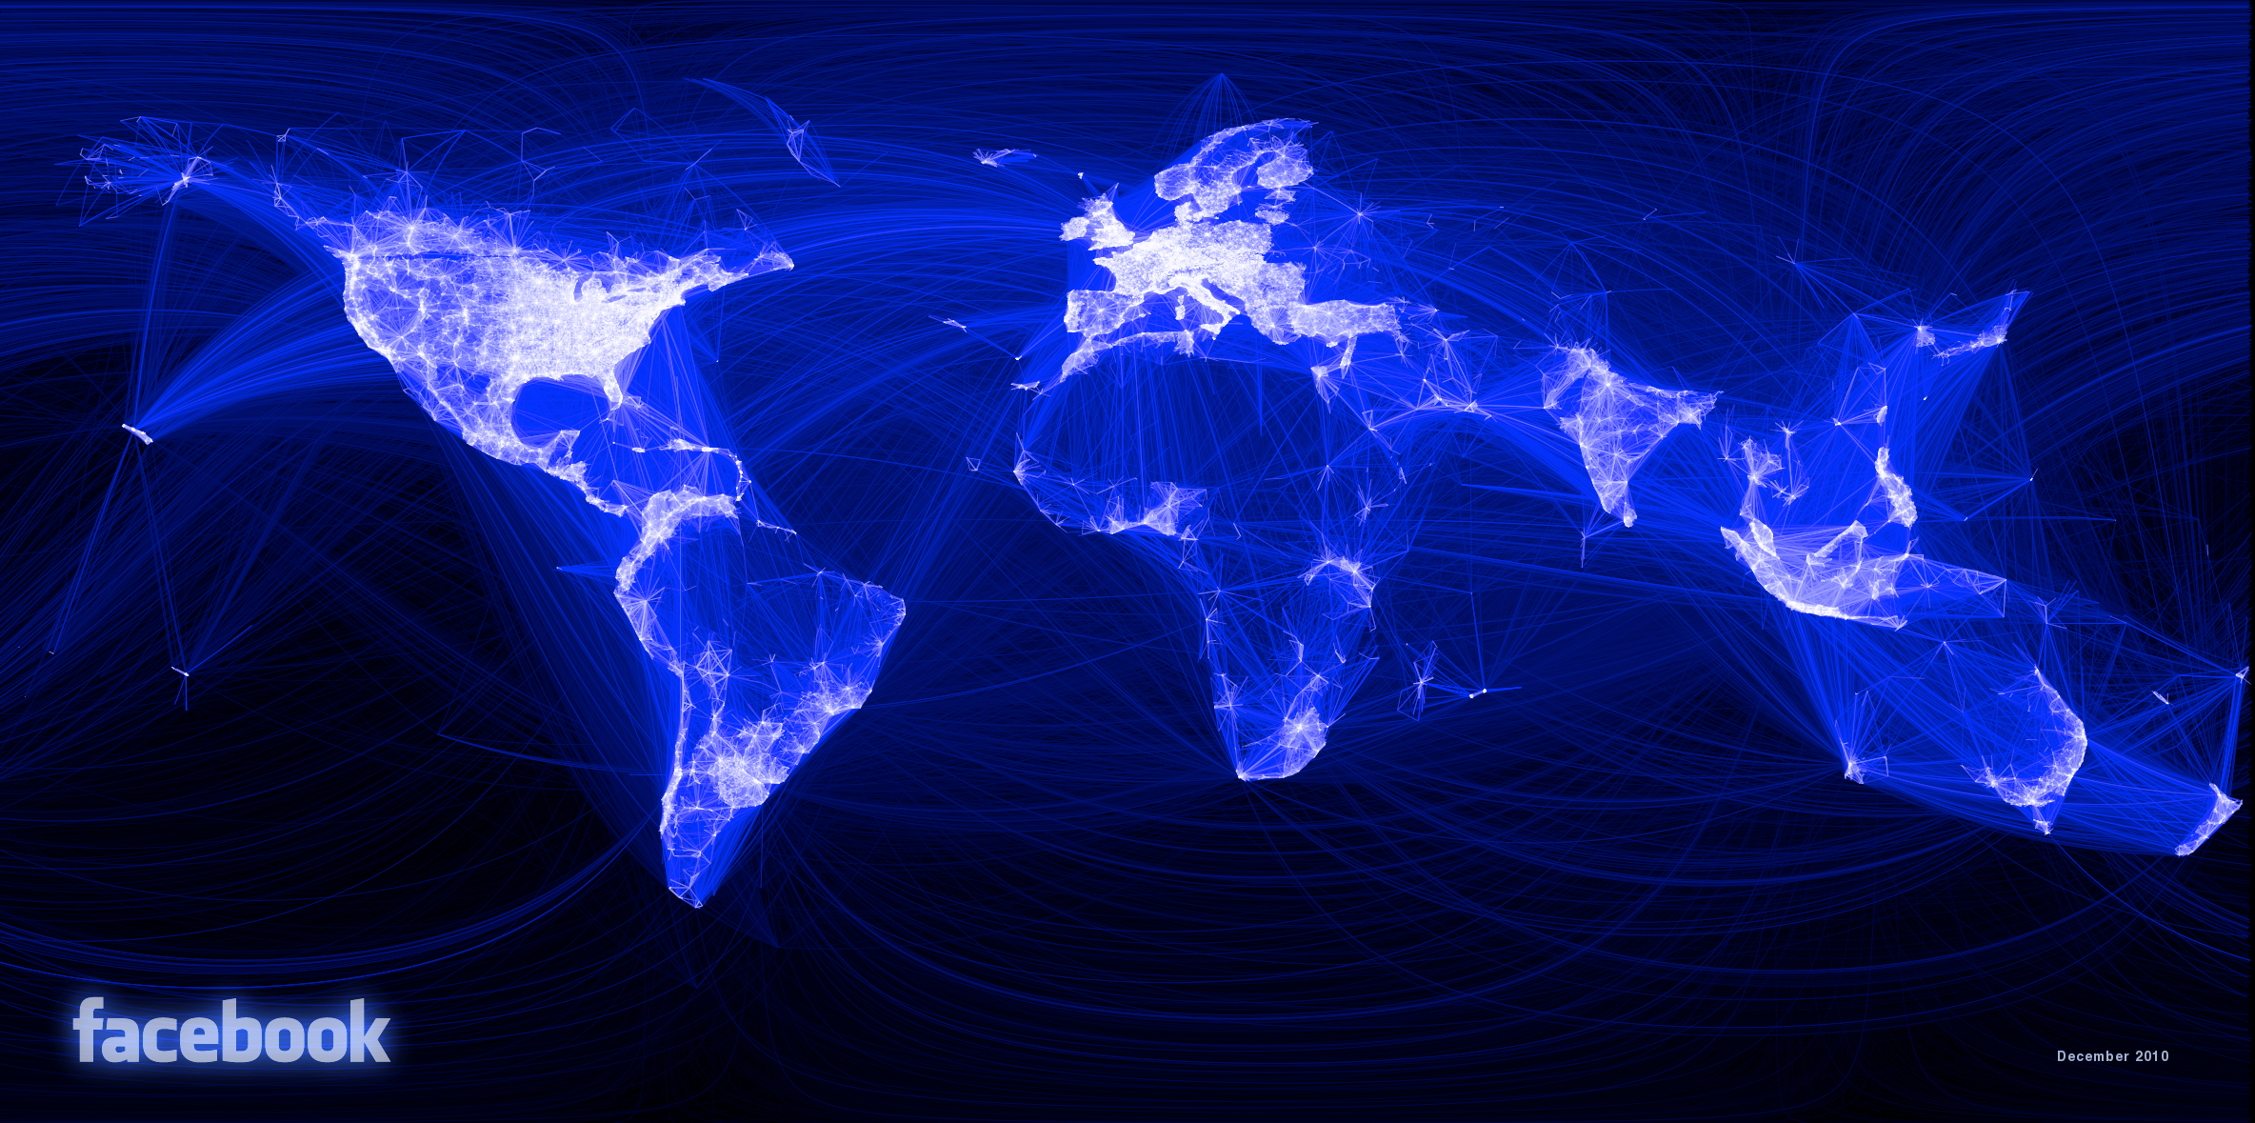
Undirected graphs
"Visualizing Friendships" by Paul Butler – an intern at Facebook

Slide 8
Graph Applications
graph | vertex | edge
communication | telephone, computer | fiber optic cable
circuit | gate, register, processor | wire
mechanical | joint | rod, beam, spring
financial | stock, currency | transactions
transportation | street intersection, airport | highway, airway route
internet | class C network | connection
social relationship | person, actor | friendship, movie cast
neural network | neuron | synapse
protein network | protein | protein-protein interaction
molecule | atom | bond

Slide 9
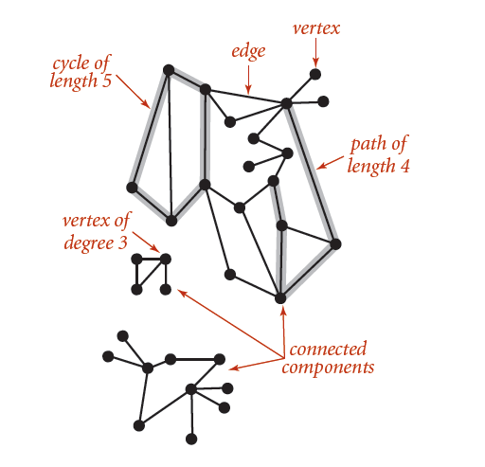
Graph Terminology

Slide 10
Graph Terminology
Path: Sequence of vertices connected by edges.
Cycle: Path whose first and last vertices are the same.
Two vertices are connected if there is a path between them.
Cycle Is there a cycle in the graph?
Euler path Is there a path that uses each edge exactly once?
Hamilton cycle Is there a cycle that uses each vertex exactly once?
Connectivity Is there a way to connect all of the vertices?
MST What is the best way to connect all of the vertices?
BiConnectivity Is there a vertex whose removal disconnects the graph?
Planarity Can you draw the graph in the plane with no crossing edges
Graph isomorphism Do two adjacency lists represent the same graph?
Challenge Which of these problems are easy? difficult? intractable?

Slide 11
Graph Representation
Graph drawing. Provides intuition about the structure of the graph.
0
3
6
7
8
5
4
1
2
7
11
9
10
3
9
10
4
8
1
5
11
12
12
2
0
6
two drawings of the same graph

Slide 12
Graph Representation
Vertex representation.
We use integers between 0 and V – 1.
Applications: convert between names and integers with symbol table.
A
0
G
6
B
C
1
2
D
E
symbol table
3
4
F
5
Anomalies
0
1
self-loop
parallel edge

Slide 13
Graph ADT
.
return type | Graph
 | Graph(int V) | create an empty graph with V vertices
 | Graph(char *fname) | create a graph from input stream
void | addEdge(int v, int w) | add an edge v-w
vector<Int> | adjacent(int V) | vertices adjacent to v
int | V() | number of vertices
int | E() | number of edges
 | toString() | string representation

Slide 14
Graph Input Format
0
graph6cc.txt
13
13
0 5
4 3
0 1
9 12
6 4
5 4
0 2
11 12
9 10
0 6
7 8
9 11
5 3
6
7
8
V
E
1
2
9
10
3
4
5
11
12
graph.cpp
read graph from input stream
Graph g = graph_by_file(argv[1]);
for (int v = 0; v < V(g); ++v) {
cout << "V[" << v << "]: ";
for (gnode w = g->adj[v].next; w; w = w->next) {
cout << w->item << " ";
(w->next == nullptr) ? (cout << endl) : (cout << "-> ");
}
}
print out edge list by vertices

Slide 15
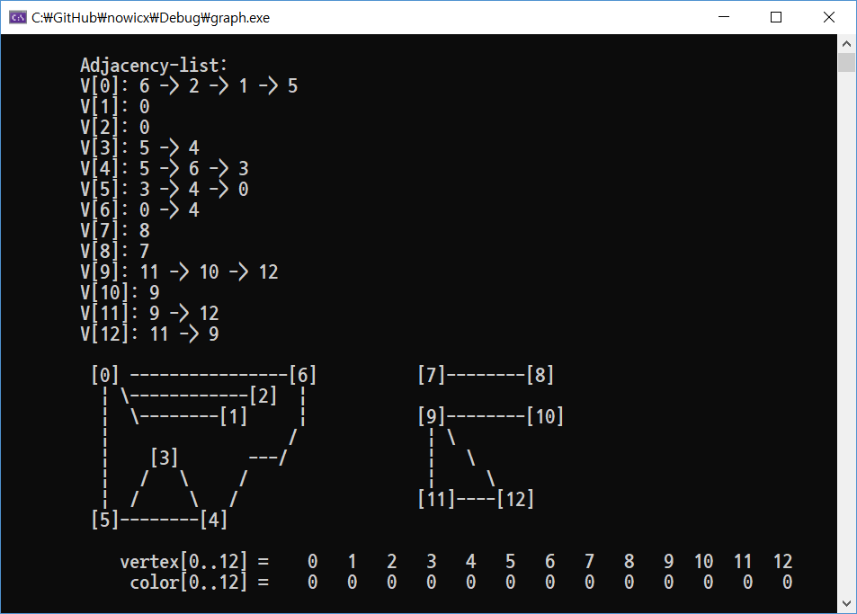
Graph Input Format
0
graph6cc.txt
13
13
0 5
4 3
0 1
9 12
6 4
5 4
0 2
11 12
9 10
0 6
7 8
9 11
5 3
6
7
8
V
E
1
2
9
10
3
4
5
11
12
graph.cpp
Graph g = graph_by_file(argv[1]);
for (int v = 0; v < V(g); ++v) {
cout << "V[" << v << "]: ";
for (gnode w = g->adj[v].next; w; w = w->next) {
cout << w->item << " ";
(w->next == nullptr) ? (cout << endl) : (cout << "-> ");
}
}

Slide 16
Graph Coding
Compute the degree of V
int degree(graph g, int v) {
if (!validVertex(g, v)) return -1;
int deg = 0;
for (gnode w = g->adj[v].next; w; w = w->next, deg++);
return deg;
}
Compute maximum degree
int degree(graph g) {
int max = 0;
for (int v = 0; v < V(g); ++v) {
int deg = degree(g, v);
if (deg > max) max = deg;
}
return max;
}
Compute average degree
double degree_average(graph g) {
int return 2.0 * E(g) / V(g);
}

Slide 17
Graph Coding – edge list
0
graph6cc.txt
13
13
0 5
4 3
0 1
9 12
6 4
5 4
0 2
11 12
9 10
0 6
7 8
9 11
5 3
1. Edge list
2. Adjacency matrix
3. Adjacency list
V
6
E
1
2
3
4
5
7
8
9
10
11
12

Slide 18
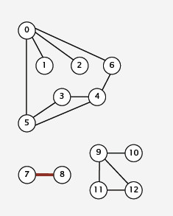
Graph Coding – edge list
Maintain a list of the edges (linked list or array)
Edge list
0 1
0 2
0 5
0 6
3 4
3 5
4 5
4 6
7 8
9 10
9 11
9 12
11 12

Slide 19
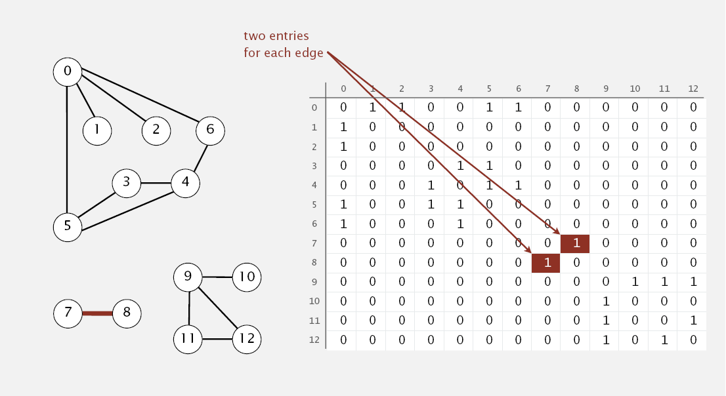
Graph Coding – Adjacency-matrix 인접행렬
Maintain a two-dimensional V-by-V Boolean array; for each edge v-w in graph: adj[v][w] = adj[w][v] = true.
Since it is undirected edge (or graph)

Slide 20
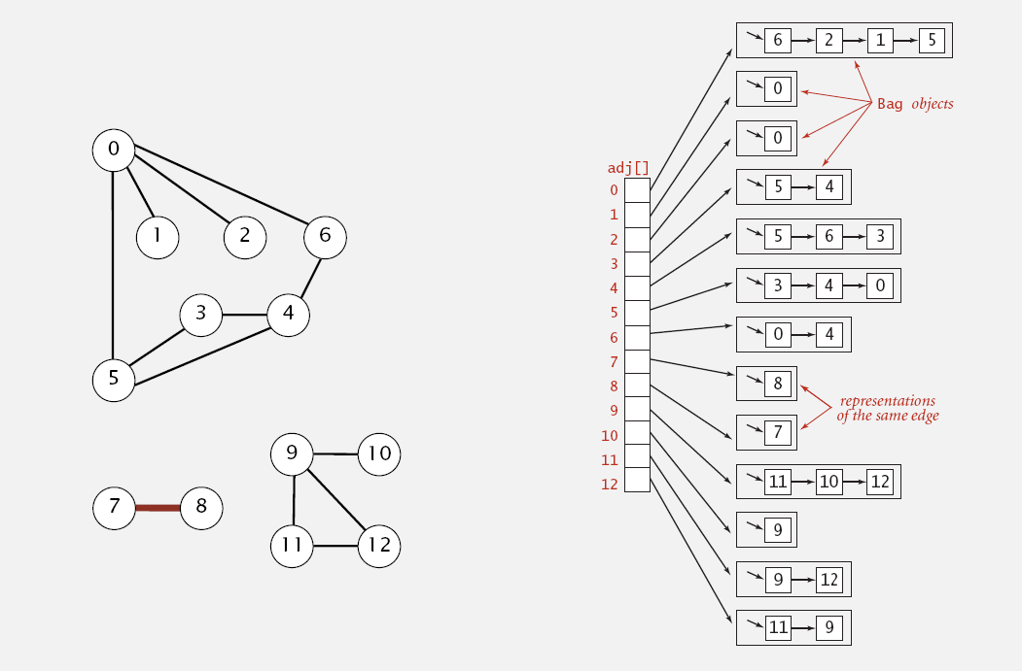
Graph Coding – Adjacency list 인접리스트
3. Maintain vertex-index array of lists.
use Bag in Java.
use a linked list in C/C++.

Slide 21
Graph Coding – graph.h
// a structure to represent an adjacency list of vertices
struct Gnode {
int item;
Gnode* next;
Gnode (int i, Gnode *p = nullptr) {
item = i; next = p;
}
~Gnode() {}
};
using gnode = Gnode *;
adjacent vertices using a singly linked list
next vertex to link if any.

Slide 22
Graph Coding – graph.cpp
struct Graph {
int V; // N vertices
int E; // N edges
gnode adj; // array of linked lists of vertices
Graph(int v = 0) { // constructs a graph with v vertices
V = v;
E = 0;
adj = new (nothrow) Gnode[v];
assert(adj != nullptr);
for (int i = 0; i < v; i++) { // initialize adj list as empty;
adj[i].next = nullptr;
adj[i].item = i;
}
}
~Graph() {}
};
using graph = Graph *;
set each adj list nullptr
to begin with
unused; but may store the degree of vertex i.
graph g = new Graph(v);
for (int i = 0; i < E; i++)
addEdge(g, from[i], to[i]);

Slide 23
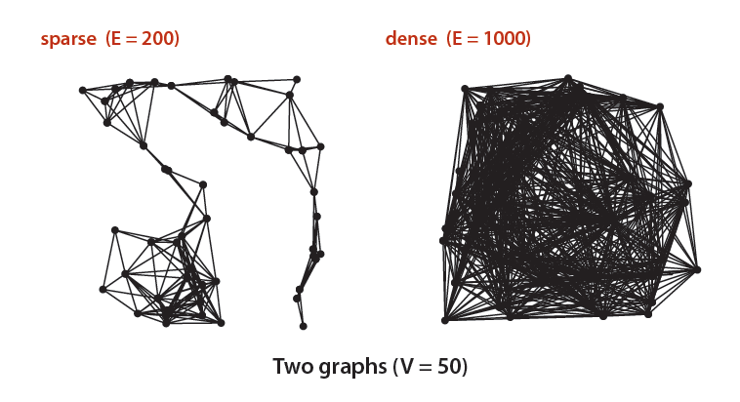
Graph Coding – Adjacency-matrix 인접행렬
In practice: Use adjacency-lists representation.
Algorithms based on iterating over vertices adjacent to v.
Real-world graphs tend to be sparse.
huge number of vertices,
small average vertex degree

Slide 24
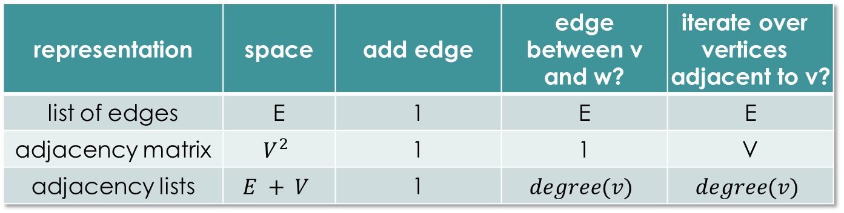
Graph Coding – Adjacency-matrix 인접행렬
In practice: Use adjacency-lists representation.
Algorithms based on iterating over vertices adjacent to v.
Real-world graphs tend to be sparse.
huge number of vertices,
small average vertex degree
representation | space | add edge | edge between v and w? | iterate over vertices adjacent to v?
list of edges | E | 1 | E | E
adjacency matrix | $$V^{2}$$ | 1 | 1 | V
adjacency lists | $$E + V$$ | 1 | $$degree(v)$$ | $$degree(v)$$

Slide 25
Data Structures Chapter 7: Graph
Introduction
Terminology, Representation, ADT
Basic Operations
DFS, CC, BFS, Processing
Digraph and Applications
Minimum Spanning Tree(MST)

